Slide 1
LLM Finetuning

Slide 2
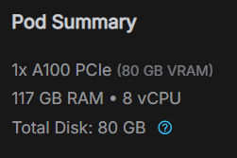
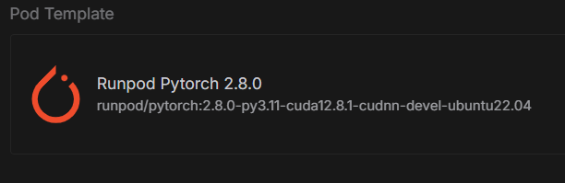
Runpod GPU Spec

Slide 3
LLM Fine-tuning techniques
Technique | Advantages | Disadvantages
Full fine-tune | Max flexibility & performance | High cost, memory, tuning time
LoRA | Low resource, fast iteration | Slight reduction in accuracy
QLoRA | Massive model on small GPUs | Setup complexity, quantization issues
FSDP-QLoRA | Larger model on multi-GPU | Sharding complexity
DeepSpeed + LoRA | Scalable for clusters | Needs customized config
Other techniques | Specialized strengths (RLHF, etc) | Varied maturity & infrastructure

Slide 4
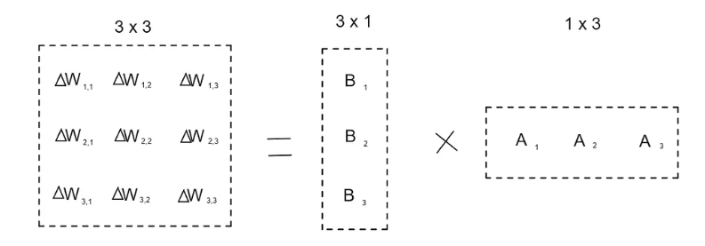
LoRA - LoRA (Low-Rank Adaptation)
LoRA can reduce the number of trainable parameters by 10,000 times and the GPU memory requirement by 3 times. LoRA performs on-par or better than fine-tuning in model quality on RoBERTa, DeBERTa, GPT-2, and GPT-3, despite having fewer trainable parameters, a higher training throughput, and, unlike adapters, no additional inference latency.

Slide 5
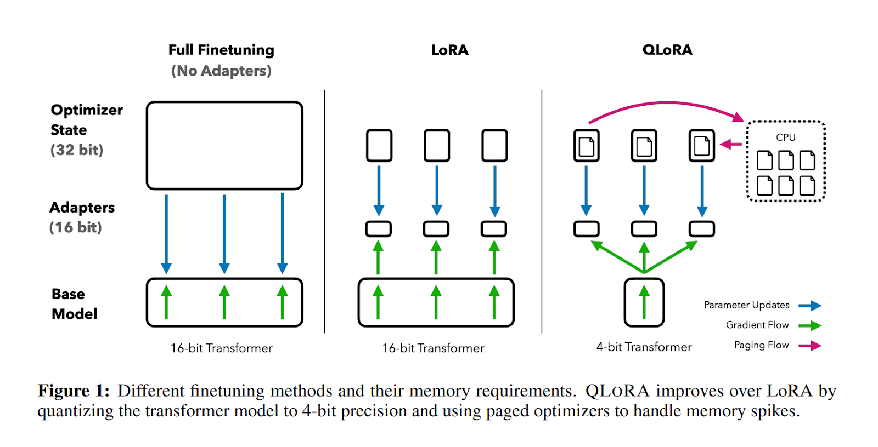
QLoRA (Quantized Low-Rank Adaptation)
It significantly reduces required GPU memory. It achieves this by quantizing the LLM to a 4-bit precision using the 4-bit NormalFloat (NF4) data type, which is more memory-efficient for pre-trained weights. QLoRA also incorporates Double Quantization to compress the quantization constants themselves, further saving memory, and utilizes Paged Optimizers to manage memory usage during training.

Slide 6
Library for LLM Finetuning - Axolotl
Resources:
https://axolotl.ai/
https://github.com/axolotl-ai-cloud/axolotl
Gemma3-4b : https://github.com/axolotl-ai-cloud/axolotl/blob/main/examples/gemma3/gemma-3-4b-qlora.yml
Llama-3-8b: https://github.com/axolotl-ai-cloud/axolotl/blob/main/examples/llama-3/instruct-lora-8b.yml

Slide 7
Library for LLM Finetuning - Axolotl
# install axolotl
pip install axolotl
# train
accelerate launch -m axolotl.cli.train gemma-3-4b-qlora.yml
from axolotl.cli import train
import sys
if __name__ == "__main__":
# pass YAML file as CLI arg
sys.argv = ["train", "gemma-3-4b-qlora.yml"]
train()

Slide 8
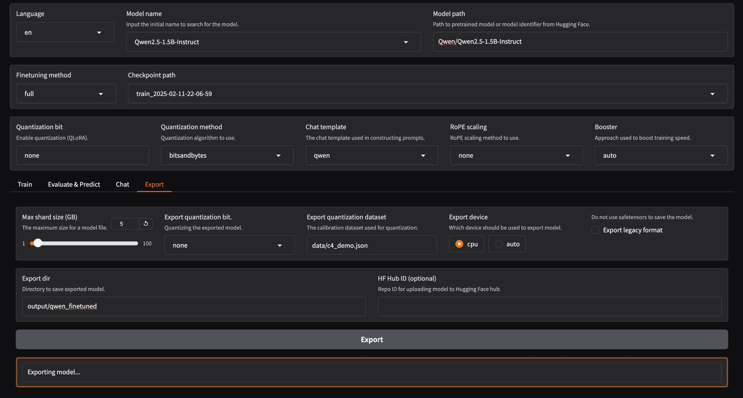
Library for LLM Finetuning - Llama Factory

Slide 9
Library for LLM Finetuning - Llama Factory
References:
https://github.com/hiyouga/LLaMA-Factory/tree/main
https://llamafactory.readthedocs.io/en/latest/
Llama 3 config: https://github.com/hiyouga/LLaMA-Factory/blob/main/examples/train_qlora/llama3_lora_sft_bnb_npu.yaml
Qwen 2 config: https://github.com/hiyouga/LLaMA-Factory/blob/main/examples/train_lora/qwen2_5vl_lora_dpo.yaml

Slide 10
Library for LLM Finetuning - Unsloth
Axolotl excels as a user-friendly framework for multi-GPU setups, offering a comprehensive, community-driven approach to fine-tuning with extensive model support and YAML configuration.
In contrast, Unsloth is specifically designed for single-GPU environments, providing unprecedented speed and memory efficiency by optimizing underlying computations for popular LLMs, using Python scripts instead of YAML for setup.
References:
https://blog.spheron.network/comparing-llm-fine-tuning-frameworks-axolotl-unsloth-and-torchtune-in-2025
https://github.com/unslothai/unsloth

Slide 11
Library for LLM Finetuning - Deepspeed
DeepSpeed focuses on multi-GPU, large-scale distributed training with techniques like ZeRO and model parallelism, while Unsloth excels at maximizing speed and memory efficiency on single or limited GPUs.
References:
https://github.com/deepspeedai/DeepSpeed
Llama2-7b: https://github.com/deepspeedai/DeepSpeedExamples/blob/master/applications/DeepSpeed-Chat/training/step1_supervised_finetuning/training_scripts/llama2/run_llama2_7b_lora.sh

Slide 12
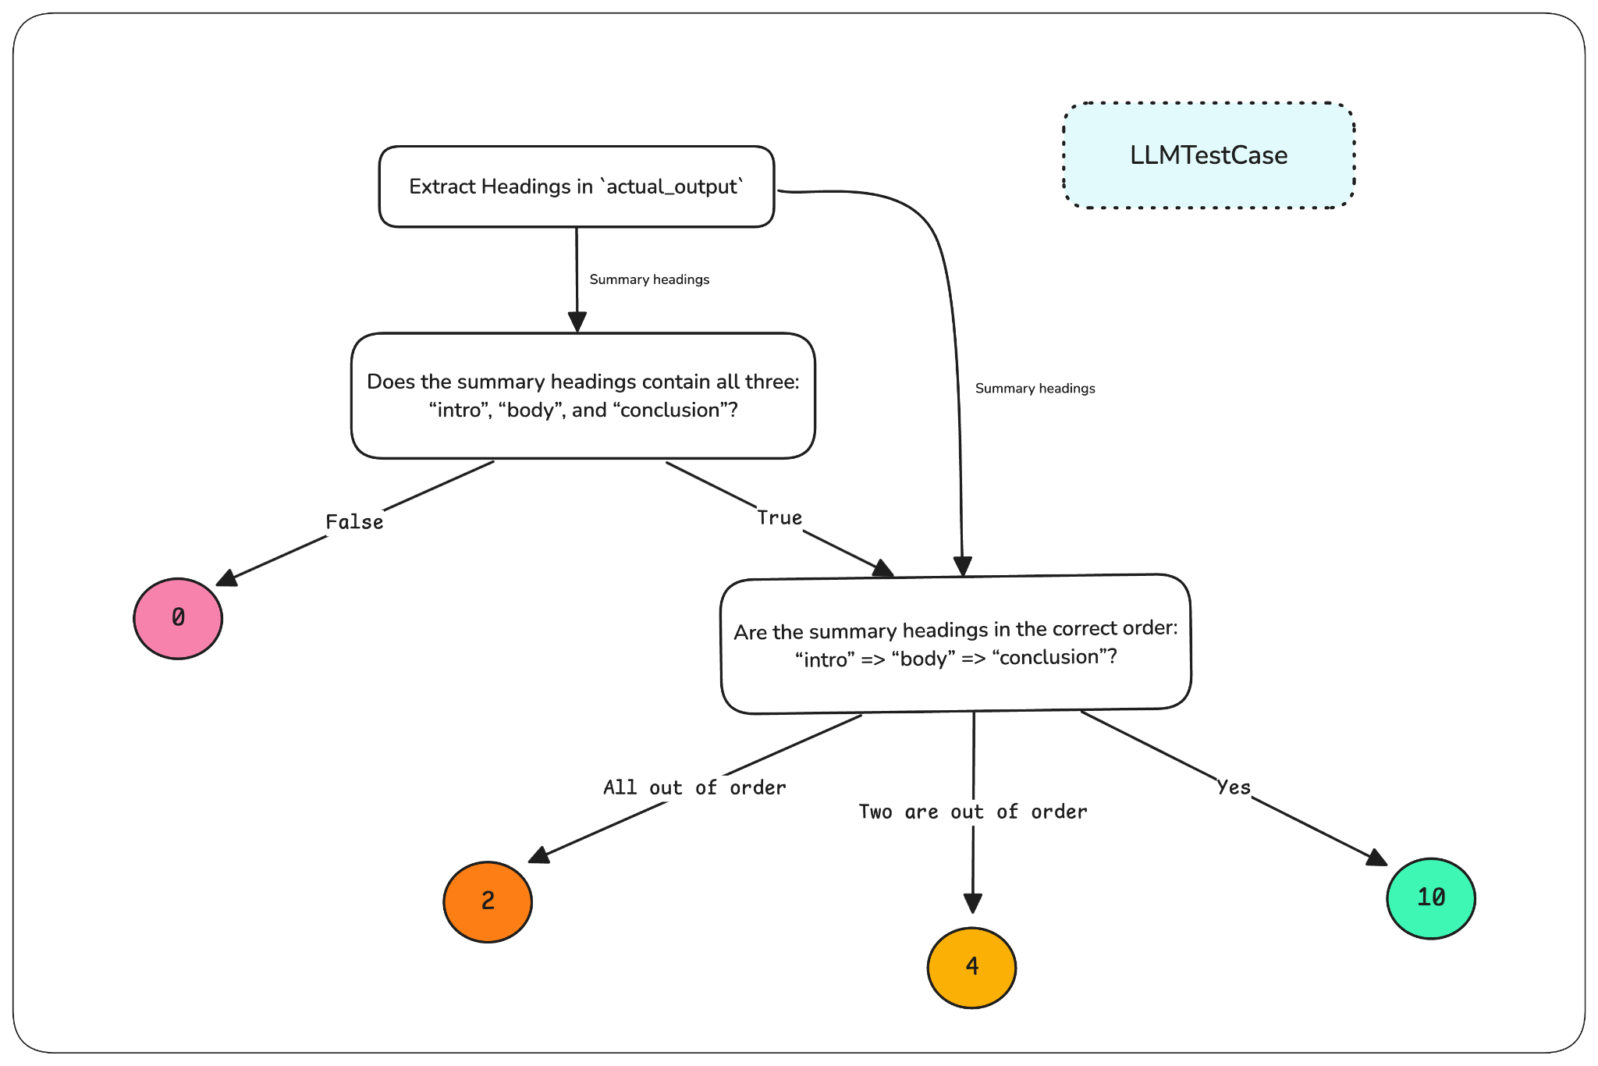
LLM Finetuning - Evaluation
HELM: https://github.com/stanford-crfm/helm
DeepEval: https://github.com/confident-ai/deepeval
DAG: DAG (Deep Acyclic Graph)
https://www.confident-ai.com/blog/llm-evaluation-metrics-everything-you-need-for-llm-evaluation

Slide 13
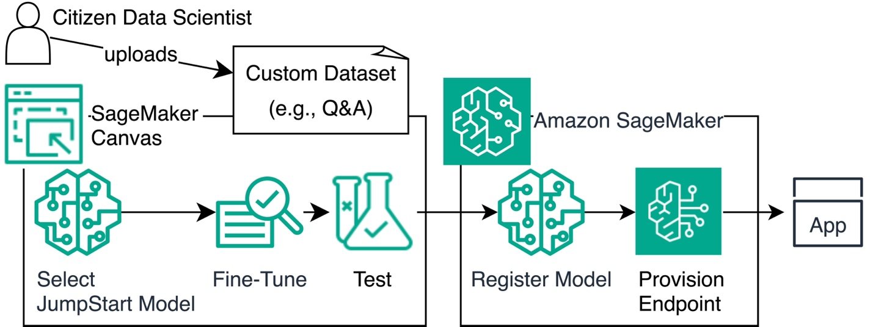
LLM Finetuning on AWS
Provides estimators within the SageMaker Python SDK to configure and initiate fine-tuning jobs on custom datasets.
SageMaker Canvas (No-Code Fine-tuning)
https://github.com/aws-samples/amazon-sagemaker-llm-fine-tuning-remote-decorator/tree/main

Slide 14
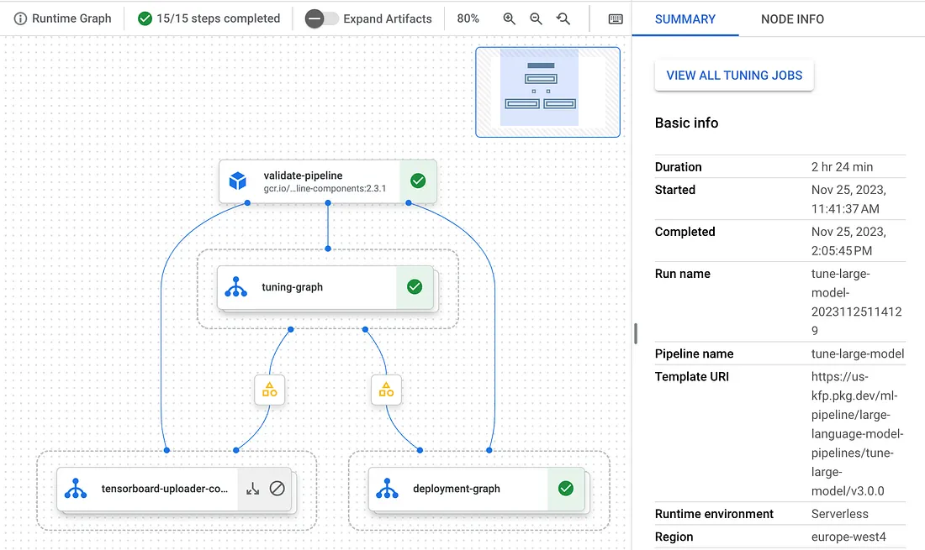
LLM Finetuning on GCP
https://codelabs.developers.google.com/llm-finetuning-supervised#7
https://cloud.google.com/use-cases/fine-tuning-ai-models?hl=en#how-fine-tuning-works-a-step-by-step-guide
https://github.com/GoogleCloudPlatform/generative-ai/blob/main/gemini/tuning/sft_gemini_qa.ipynb

Slide 15
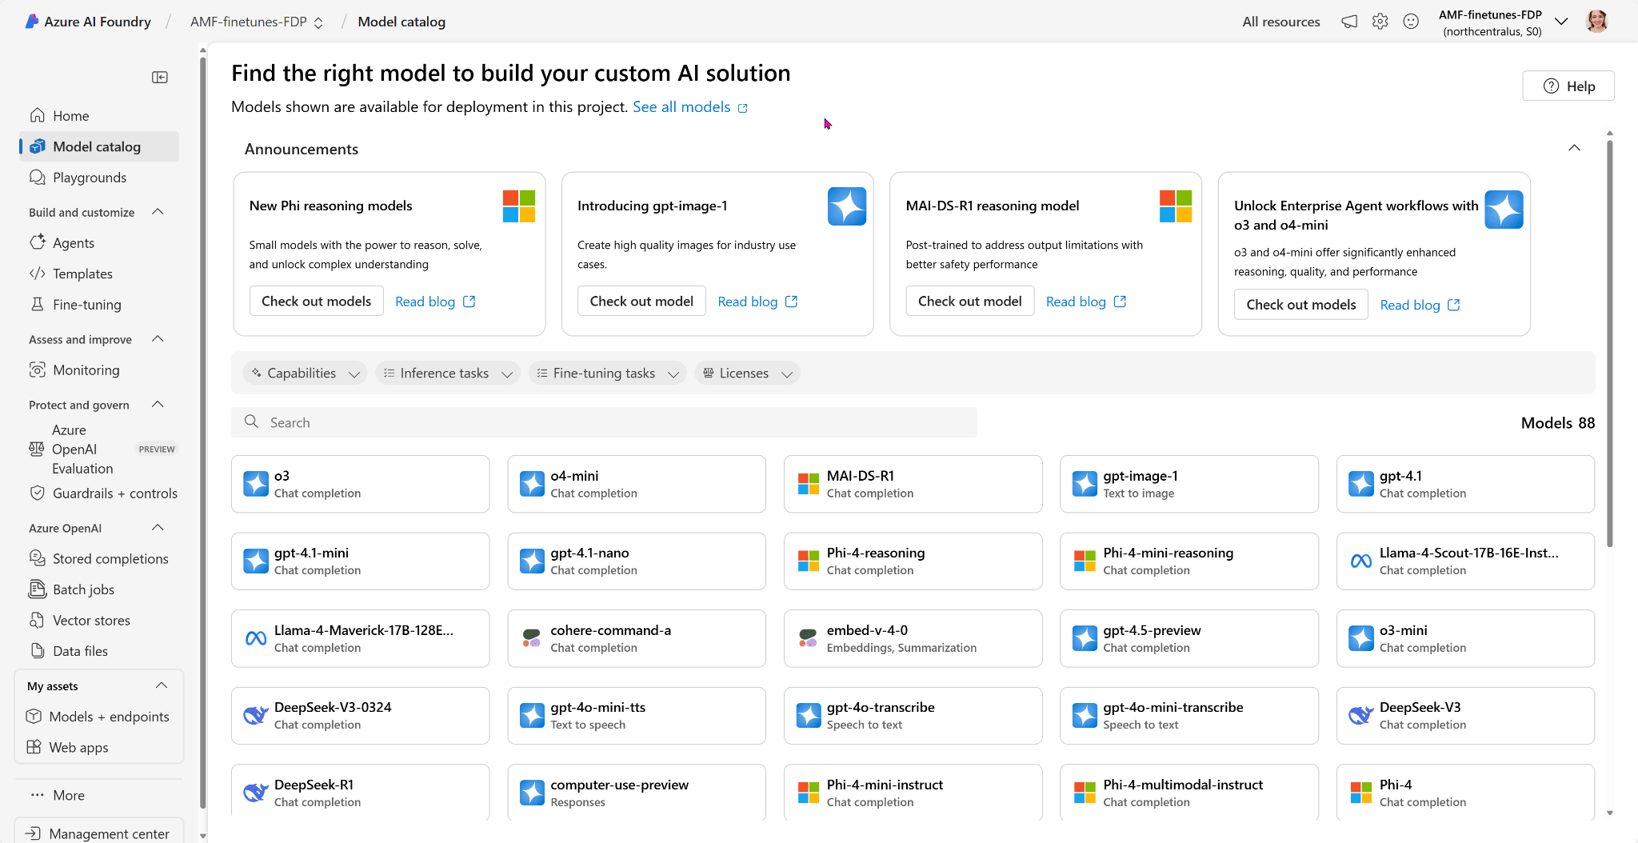
LLM Finetuning on Azure
Azure ML Python SDK
https://learn.microsoft.com/en-us/azure/ai-foundry/concepts/fine-tuning-overview
Azure AI Foundry
Phi-3 training
https://github.com/Azure/azure-llm-fine-tuning/blob/main/phi3/1_training_custom_phi3.ipynb

